Slide 1
Databases
Group 19
Girish Kumar M P – 106119038
Mohan Kumar G – 106119078
M Shriram – 106119080
S Suseendhar - 106119122

Slide 2
Entity relationship(ER) Model
Entity Relational model is a model for identifying entities to be represented in the database and representation of how those entities are related.
The ER data model specifies enterprise schema that represents the overall logical structure of a database graphically.
E-R diagrams are used to model real-world objects like a person, a car, a company and the relation between these real-world objects.

Slide 3
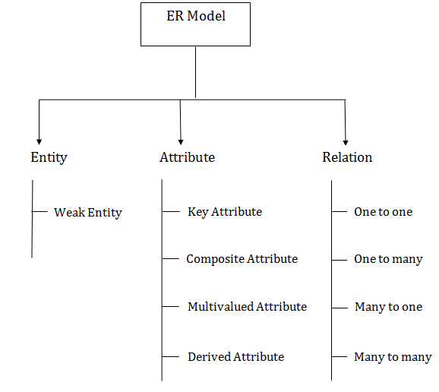
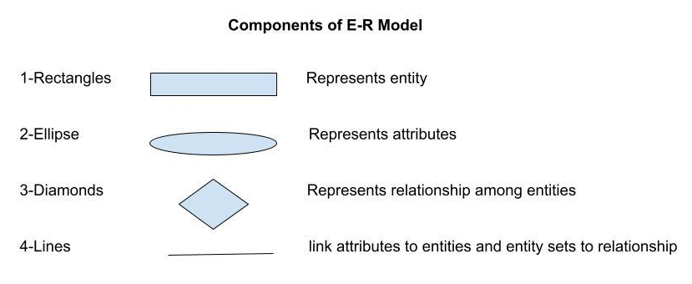
Components of ER Model

Slide 4
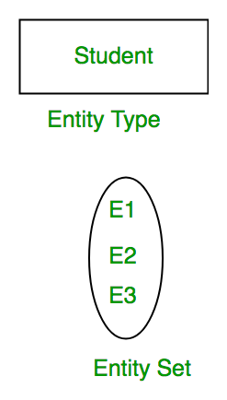
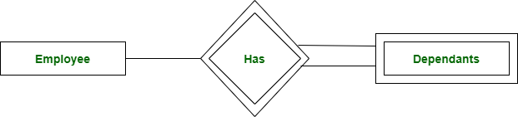
Entity and Entity Set
An entity may be any object, class, person or place. In the ER diagram, an entity can be represented as rectangles.
Consider an organization as an example – manager, product, employee, department etc. can be taken as an entity.
Weak Entity
An entity that depends on another entity called a weak entity. The weak entity doesn't contain any key attribute of its own. The weak entity is represented by a double rectangle.
An Entity is an object of Entity Type, and a set of all entities is called as an entity set
Notes:
An entity type should have a key attribute which uniquely identifies each entity in the entity set, but there exists some entity type for which key attribute can’t be defined. These are called Weak Entity type. The entity sets which do not have sufficient attributes to form a primary key are known as weak entity sets and the entity sets which have a primary key are known as strong entity sets.
e.g.; E1 is an entity having Entity Type Student and set of all students is called Entity Set. In ER diagram, Entity Type is represented as:

Slide 5
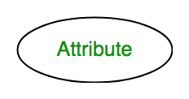
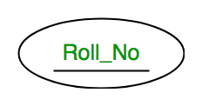
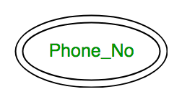
Attributes
Attributes are the properties that define the entity type. For example, Roll_No, Name, DOB, Age, Address, Mobile_No are the attributes that define entity type Student. In ER diagram, the attribute is represented by an ellipse.
1. Key Attribute –
The attribute which uniquely identifies each entity in the entity set is called key attribute. For example, Roll_No will be unique for each student. In ER diagram, key attribute is represented by an ellipse with underlying lines.
2. Multivalued Attribute –
An attribute consisting more than one value for a given entity. For example, Phone_No (can be more than one for a given student). In ER diagram, a multivalued attribute is represented by a double ellipse.

Slide 6
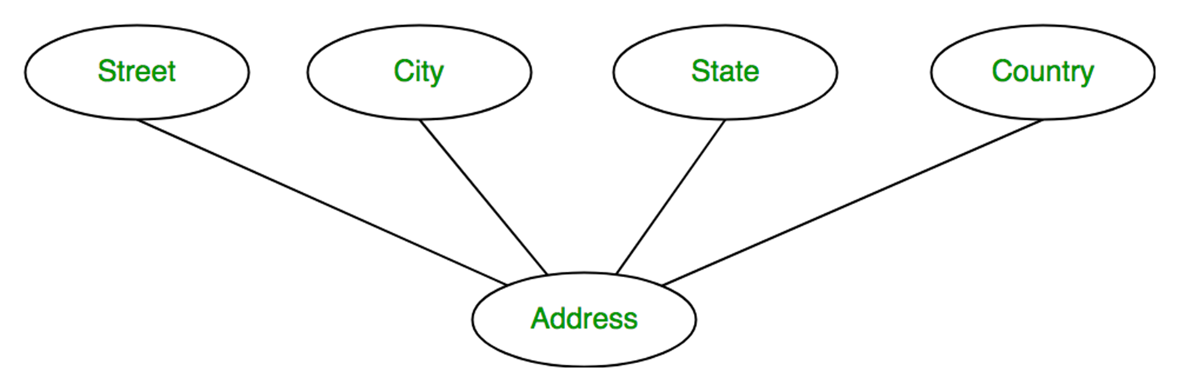
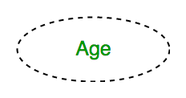
3. Composite Attribute
An attribute composed of many other attribute is called as composite attribute. For example, Address attribute of student Entity type consists of Street, City, State, and Country. In ER diagram, composite attribute is represented by an ellipse comprising of ellipses.
4. Derived Attribute
An attribute that can be derived from other attributes of the entity type is known as a derived attribute. e.g.; Age (can be derived from DOB). In ER diagram, the derived attribute is represented by a dashed ellipse.

Slide 7
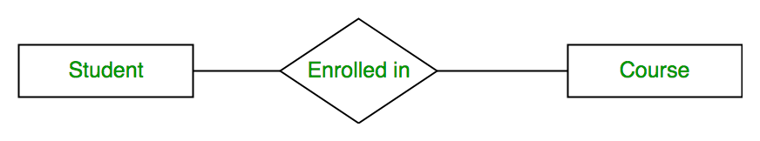
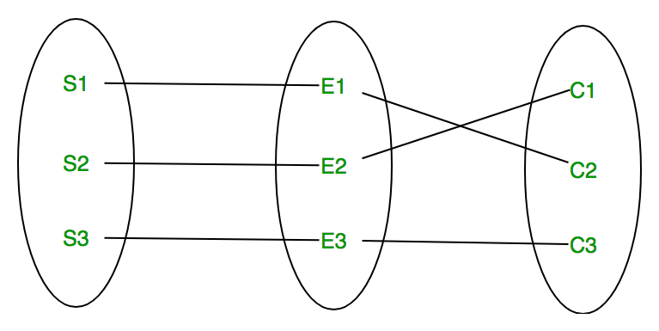
Relation
A relationship type represents the association between entity types. For example, ‘Enrolled in’ is a relationship type that exists between entity type Student and Course. In ER diagram, the relationship type is represented by a diamond and connecting the entities with lines.
A set of relationships of the same type is known as a relationship set. The following relationship set depicts S1 is enrolled in C2, S2 is enrolled in C1, and S3 is enrolled in C3.

Slide 8
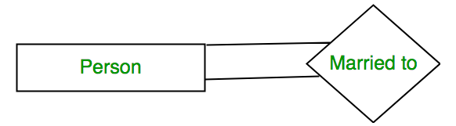
Degree of a relationship set
The number of different entity sets participating in a relationship set is called as the degree of a relationship set.
1. Unary Relationship –
When there is only ONE entity set participating in a relation, the relationship is called a unary relationship. For example, one person is married to only one person.
2. Binary Relationship –
When there are TWO entities set participating in a relationship, the relationship is called a binary relationship. For example, a Student is enrolled in a Course.

Slide 9
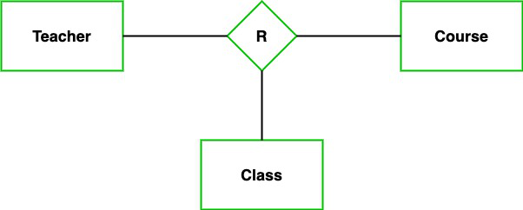
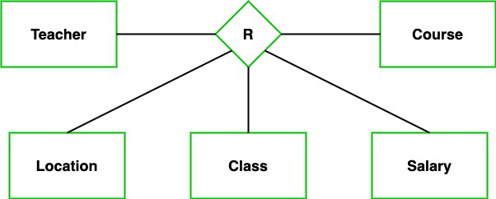
3. Ternary Relationship –
In the Ternary relationship, there are three types of entity associates. So, we can say that a Ternary relationship exists when there are three types of entity, and we call them a degree of relationship is 3.
4. n-ary Relationship –
When there are n entities set participating in a relation, the relationship is called an an n-ary relationship.

Slide 10
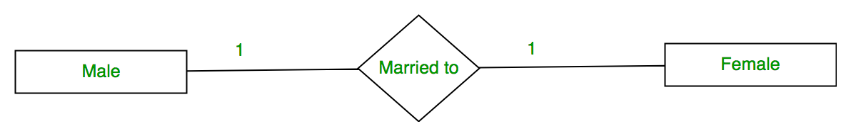
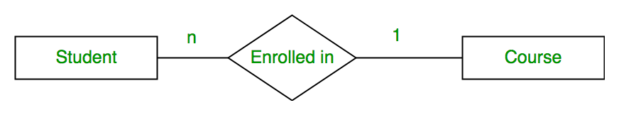
Types of relation based on Cardinality
The number of times an entity of an entity set participates in a relationship set is known as cardinality. Cardinality can be of different types:
1. One-to-one – When each entity in each entity set can take part only once in the relationship, the cardinality is one-to-one
2. Many to one – When entities in one entity set can take part only once in the relationship set and entities in other entity sets can take part more than once in the relationship set, cardinality is many to one
Notes:
Please don’t cancel me ☹

Slide 11
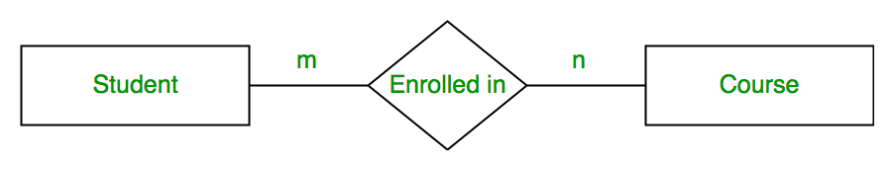
3. Many to many – When entities in all entity sets can take part more than once in the relationship cardinality is many to many

Slide 12
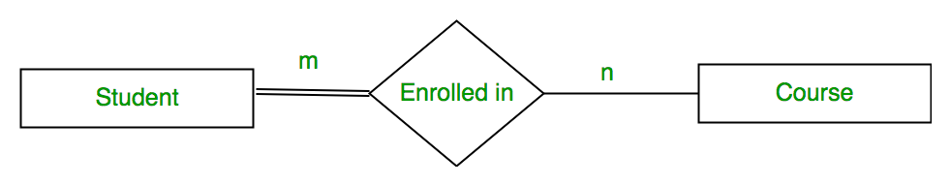
Participation Constraint
Participation Constraint is applied to the entity participating in the relationship set.
1. Total Participation – Each entity in the entity set must participate in the relationship. If each student must enroll in a course, the participation of students will be total. Total participation is shown by a double line in the ER diagram.
2. Partial Participation – The entity in the entity set may or may not participate in the relationship. If some courses are not enrolled by any of the students, the participation of the course will be partial.
The diagram depicts the ‘Enrolled in’ relationship set with Student Entity set having total participation and Course Entity set having partial participation.
Notes:
Total Participation-
Double line between the entity set “Student” and relationship set “Enrolled in” signifies total participation. It specifies that each student must be enrolled in at least one course. 2. Partial Participation- Single line between the entity set “Course” and relationship set “Enrolled in” signifies partial participation. It specifies that there might exist some courses for which no enrollments are made.

Slide 13
Questions
Which one of the following is used to represent the supporting many-one relationships of a weak entity set in an entity-relationship diagram? [GATE 2020]
A. Rectangles with double/bold border
B. Diamonds with double/bold border
C. Ovals that contain underlined identifiers
D. Ovals with double/bold border

Slide 14
Questions
Which one of the following is used to represent the supporting many-one relationships of a weak entity set in an entity-relationship diagram? [GATE 2020]
A. Rectangles with double/bold border
B. Diamonds with double/bold border
C. Ovals that contain underlined identifiers
D. Ovals with double/bold border
Ans: B
Explanation: A – Weak entity set
B – Relationship of a weak entity set
C – Key Attribute
D – Multivalued Attribute

Slide 15
Questions
Which of the following is incorrect about an ER Model. [ Gate 2012]
(a) An attribute of an Entity can have more than one value.
(b) An attribute of an entity can be composite.
(c) In a row of a relational table an attribute can have more than one value.
(d) In a row of a relational table an attribute can have exactly one value or NULL.

Slide 16
Questions
Which of the following is incorrect about an ER Model. [ Gate 2012]
(a) An attribute of an Entity can have more than one value.
(b) An attribute of an entity can be composite.
(c) In a row of a relational table an attribute can have more than one value.
(d) In a row of a relational table an attribute can have exactly one value or NULL.
Ans: c
Explanation: In Relational Database Model in a Table or Relation, Row or tuple of the table can not have more than one value for an attribute.

Slide 18
Relational Model: Relational Algebra
Relational algebra is a procedural query language, which takes instances of relations as input and yields instances of relations as output
It gives a step-by-step process to obtain the result of the query.
It uses operators to perform queries.
Notes:
Any relational database systems are expected to be equipped with a query language that can assist its users to query the database instances.
The first query language that we are going to see is relational algebra.

Slide 19
Types of relational operators
1. Select Operation:
The select operation selects tuples that satisfy a given predicate.
It is denoted by sigma (σ).
Notation: σ p(r)
Where:
σ is used for selection prediction
r is used for relation
p is used as a propositional logic formula which may use connectors like: AND OR and NOT. These relational can use as relational operators like =, ≠, ≥, <, >, ≤.
E.g.,
σ(subject = "database“ and price = "450" ) (Books)
Output − Selects tuples from books where subject is 'database’ and 'price' is 450.

Slide 20
2. Project Operation:
This operation shows the list of those attributes that we wish to appear in the result. Rest of the attributes are eliminated from the table.
It is denoted by ∏.
Notation: ∏ A1, A2, An (r)
Where:
A1, A2, A3 is used as an attribute name of relation r.
E.g., ∏(subject, author) (Books) - Selects and projects columns named as subject and author from the relation Books.
3. Union Operation:
Suppose there are two tuples R and S. The union operation contains all the tuples that are either in R or S or both in R & S.
It eliminates the duplicate tuples. It is denoted by ∪.
Notation: R ∪ S
A union operation must hold the following condition:
R and S must have the attribute of the same number.
Duplicate tuples are eliminated automatically.
E.g., ∏ author (Books) ∪ ∏ author (Articles) - Projects the names of the authors who have either written a book or an article or both.

Slide 21
4. Set Intersection:
Suppose there are two tuples R and S. The set intersection operation contains all tuples that are in both R & S.
It is denoted by intersection ∩.
Notation: R ∩ S
E.g., ∏ author (Books) ∩ ∏ author (Articles) - Projects the names of the authors who have written both a book and an article.
5. Set Difference:
Suppose there are two tuples R and S. The set intersection operation contains all tuples that are in R but not in S.
It is denoted by intersection minus (-).
Notation: R - S
E.g., ∏ author (Books) − ∏ author (Articles)
Output − Provides the name of authors who have written books but not articles.

Slide 22
6. Cartesian product
The Cartesian product is used to combine each row in one table with each row in the other table. It is also known as a cross product.
It is denoted by X.
Notation: E X D
7. Rename Operation:
The rename operation is used to rename the output relation. It is denoted by rho (ρ).
Example: We can use the rename operator to rename STUDENT relation to STUDENT1.
ρ(STUDENT1, STUDENT)

Slide 23
Relational Calculus
In contrast to Relational Algebra, Relational Calculus is a non-procedural query language, that is, it tells what to do but never explains how to do it.
In the non-procedural query language, the user is concerned with the details of how to obtain the end results.
The relational calculus tells what to do but never explains how to do
Many of the calculus expressions involves the use of Quantifiers. There are two types of quantifiers:
Universal Quantifiers: The universal quantifier denoted by ∀ is read as for all which means that in a given set of tuples exactly all tuples satisfy a given condition.
Existential Quantifiers: The existential quantifier denoted by ∃ is read as there exists which means that in a given set of tuples there is at least one occurrences whose value satisfy a given condition.

Slide 24
Types of Relational calculus:
1. Tuple Relational Calculus (TRC)
Filtering variable ranges over tuples
Notation − {T | Condition}
Returns all tuples T that satisfies a condition.
example: { T.name | Author(T) AND T.article = 'database’ }
2. Domain Relational Calculus (DRC)
In DRC, the filtering variable uses the domain of attributes instead of entire tuple values (as done in TRC, mentioned above).
Notation − { a1, a2, a3, ..., an | P (a1, a2, a3, ... ,an)}
Where a1, a2 are attributes and P stands for formulae built by inner attributes.
For example − {< article, page, subject > | ∈ TutorialsPoint ∧ subject = 'database'}

Slide 25
Tuple Relational Calculus
Tuple Relational Calculus (TRC) is a non-procedural query language used in relational database management systems (RDBMS) to retrieve data from tables.
TRC is based on the concept of tuples, which are ordered sets of attribute values that represent a single row or record in a database table.
TRC is a declarative language, meaning that it specifies what data is required from the database, rather than how to retrieve it. TRC queries are expressed as logical formulas that describe the desired tuples.
The basic syntax of TRC is as follows:
{ t | P(t) }
where t is a tuple variable and P(t) is a logical formula that describes the conditions that the tuples in the result must satisfy. The curly braces {} are used to indicate that the expression is a set of tuples.

Slide 26
TRC example
Queries-1: Find the loan number, branch, amount of loans of greater than or equal to 10000 amount.
Result:
{t| t ∈ loan ∧ t[amount]>=10000}
Table: Loan
Loan number | Branch name | Amount
L33 | ABC | 10000
L35 | DEF | 15000
L49 | GHI | 9000
L98 | DEF | 65000
Loan number | Branch name | Amount
L33 | ABC | 10000
L35 | DEF | 15000
L98 | DEF | 65000

Slide 27
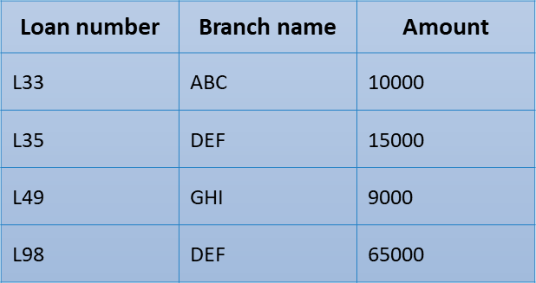
Query-2: Find the loan number for each loan of an amount greater or equal to 10000.
Result:
{t| ∃ s ∈ loan(t[loan number] = s[loan number] ∧ s[amount]>=10000)}
Table: Loan
Loan number
L33
L35
L98

Slide 29
SQL
SQL stands for Structured Query Language.
SQL lets you access and manipulate databases.
SQL is a database computer language designed for the retrieval and management of data in a relational databases like MySQL, MS Access, SQL Server, MS Access, Oracle, Sybase, Informix, Postgres etc.

Slide 30
RDBMS
RDBMS stands for Relational Database Management System. RDBMS is the basis for SQL, and for all modern database systems like MS SQL Server, IBM DB2, Oracle, MySQL, and Microsoft Access.
Table: The data in an RDBMS is stored in database objects which are called as tables. This table is basically a collection of related data entries, and it consists of numerous columns and rows.
Field: Every table is broken up into smaller entities called fields
Row/Record: A record is also called as a row of data is each individual entry that exists in a table
Column: A column is a vertical entity in a table that contains all information associated with a specific field in a table

Slide 31
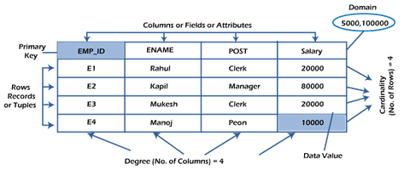

Slide 32
SQL Basic Commands
Data Manipulation Language
Data Definition Language
SQL Commands
Transaction Control Language

Slide 33
DDL - Data Definition Language
CREATE Creates a table in the database. We can specify the name of the table and the columns that should be in the table.
CREATE TABLE table_name(column_1 datatype, column_2 datatype, column_3 datatype);
ALTER Modifies an existing database object, such as a table.
ALTER TABLE table_name ADD column_name datatype;
DROP Deletes an entire table, a view of a table or other objects in the database.
DROP DATABASE database_name;
DROP TABLE table_name;
TRUNCATE Deletes the data inside a table, but not the table itself.
TRUNCATE TABLE table_name;

Slide 34
DML - Data Manipulation Language
SELECT Retrieves certain records or all records from one or more tables.
SELECT column1, column2, ... FROM table_name;
SELECT * FROM table_name;
INSERT Inserts data into a table.
INSERT INTO table_name (column_1, column_2, column_3) VALUES (value_1, value_2, value_3);
UPDATE Modifies existing records.
UPDATE table_name SET column1 = value1, column2 = value2, ... WHERE condition;
DELETE Deletes existing records.
DELETE FROM table_name WHERE condition;

Slide 35
TCL (Transaction Control Language):
A transaction is a sequence of queries and update statements executed as a single unit. Transactions are started implicitly.
BEGIN: Opens a Transaction.
COMMIT: Commits a Transaction.
ROLLBACK: Rollbacks a transaction in case of any error occurs.
SAVEPOINT: Sets a save point within a transaction.
SET TRANSACTION: Specifies characteristics for the transaction.

Slide 36
SQL Clauses
SQL DISTINCT Clause – returns only distinct (different) values.
SELECT DISTINCT column1, column2, ... FROM table_name;
SQL WHERE Clause – used to filter records
SELECT column1, column2, ... FROM table_name WHERE condition;
SQL AND, OR and NOT operators – used in combination with WHERE clause
AND – displays records if all conditions are true.
OR – displays records if any one condition is true.
NOT – displays records if conditions are not true.
SELECT column1, column2, ... FROM table_name WHERE condition1 AND condition2 AND condition3 ...;

Slide 37
SQL IN Clause – allows us to specify multiple values in a WHERE clause.
SELECT column_name(s) FROM table_name WHERE column_name IN (value1, value2, ...);
SQL BETWEEN Clause – selects values within a given range.
SELECT column_name(s) FROM table_name WHERE column_name BETWEEN value1 AND value2;
SQL LIKE Clause – select rows when a column has a certain pattern of characters contained in it.
SELECT column_name(s) FROM table_name WHERE column_name LIKE {pattern};
SQL ORDER BY Clause – used to sort the result-set in ascending or descending order.
SELECT column1, column2, ... FROM table_name ORDER BY column1, column2, ... ASC|DESC;

Slide 38
SQL GROUP BY Clause – groups rows that have the same values into summary rows
SELECT column_name(s) FROM table_name WHERE condition GROUP BY column_name(s);
SQL COUNT() - returns the no.of rows that matches a specified criterion.
SELECT COUNT(column_name) FROM table_name WHERE condition;
SQL AVG() - returns the average value of a numeric column.
SELECT AVG(column_name) FROM table_name WHERE condition;
SQL SUM() - returns the total sum of a numeric column.
SELECT SUM(column_name) FROM table_name WHERE condition;

Slide 39
SQL HAVING Clause
SELECT column_name(s) FROM table_name WHERE condition GROUP BY column_name(s) HAVING condition ORDER BY column_name(s);

Slide 40
SQL constraints
Constraints are the rules enforced on data columns on a table. These are used to limit the type of data that can go into a table. This ensures the accuracy and reliability of the data in the database.
Constraints can either be column level or table level. Column level constraints are applied only to one column whereas, table level constraints are applied to the entire table.
NOT NULL Constraint – Ensures that a column cannot have a NULL value.
DEFAULT Constraint – Provides a default value for a column when none is specified.
UNIQUE Constraint – Ensures that all the values in a column are different.
PRIMARY Key – Uniquely identifies each row/record in a database table.
FOREIGN Key – Uniquely identifies a row/record in any another database table.
CHECK Constraint – Ensures that all values in a column satisfy certain conditions.
INDEX – Used to create and retrieve data from the database very quickly.

Slide 41
Data Types
Exact Numeric Data Types
Approximate Numeric Data Types
DATA TYPE | FROM | TO
bigint | -9,223,372,036,854,775,808 | 9,223,372,036,854,775,807
int | -2,147,483,648 | 2,147,483,647
smallint | -32,768 | 32,767
tinyint | 0 | 255
bit | 0 | 1
decimal | -10^38 +1 | 10^38 -1
numeric | -10^38 +1 | 10^38 -1
money | -922,337,203,685,477.5808 | +922,337,203,685,477.5807
smallmoney | -214,748.3648 | +214,748.3647
DATA TYPE | FROM | TO
float | -1.79E + 308 | 1.79E + 308
real | -3.40E + 38 | 3.40E + 38
Date and Time Data Types
DATA TYPE | FROM | TO
datetime | Jan 1, 1753 | Dec 31, 9999
smalldatetime | Jan 1, 1900 | Jun 6, 2079
date | Stores a date like June 30, 1991
time | Stores a time of day like 12:30 P.M.

Slide 42
Character Strings Data Types
Unicode Character Strings Data Types
Sr.No. | DATA TYPE & Description
1 | char Maximum length of 8,000 characters.( Fixed length non-Unicode characters)
2 | varchar Maximum of 8,000 characters.(Variable-length non-Unicode data).
3 | varchar(max) Maximum length of 2E + 31 characters, Variable-length non-Unicode data (SQL Server 2005 only).
4 | text Variable-length non-Unicode data with a maximum length of 2,147,483,647 characters.
Sr.No. | DATA TYPE & Description
1 | nchar Maximum length of 4,000 characters.( Fixed length Unicode)
2 | nvarchar Maximum length of 4,000 characters.(Variable length Unicode)
3 | nvarchar(max) Maximum length of 2E + 31 characters (SQL Server 2005 only).( Variable length Unicode)
4 | ntext Maximum length of 1,073,741,823 characters. ( Variable length Unicode )

Slide 43
Binary Data Types
Misc Data Types
Sr.No. | DATA TYPE & Description
1 | binary Maximum length of 8,000 bytes(Fixed-length binary data )
2 | varbinary Maximum length of 8,000 bytes.(Variable length binary data)
3 | varbinary(max) Maximum length of 2E + 31 bytes (SQL Server 2005 only). ( Variable length Binary data)
4 | image Maximum length of 2,147,483,647 bytes. ( Variable length Binary Data)
Sr.No. | DATA TYPE & Description
1 | sql_variant Stores values of various SQL Server-supported data types, except text, ntext, and timestamp.
2 | timestamp Stores a database-wide unique number that gets updated every time a row gets updated
3 | uniqueidentifier Stores a globally unique identifier (GUID)
4 | xml Stores XML data. You can store xml instances in a column or a variable (SQL Server 2005 only).
5 | cursor Reference to a cursor object
6 | table Stores a result set for later processing

Slide 44
Operators
SQL Arithmetic Operators
Addition (+)
Subtraction (-)
Multiplication (*)
Division (/)
Modulus (%)
SQL Logical Operators
ALL
AND
ANY
BETWEEN
EXISTS
IN
LIKE
NOT
OR
IS NULL
UNIQUE
SQL Comparison Operators
=
!=
<>
>
<
>=
<=
!>
!<

Slide 45
SQL Join
SQL Join statement is used to combine data or rows from two or more tables based on a common field between them. Different types of Joins are as follows:
INNER JOIN
LEFT JOIN
RIGHT JOIN
FULL JOIN
NATURAL JOIN

Slide 46
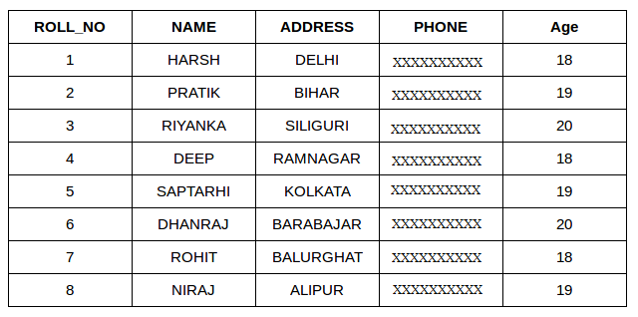
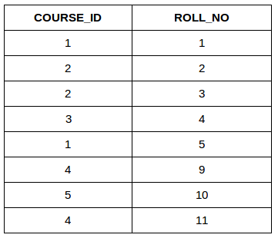
Consider the two tables below:
Student Student Course

Slide 47
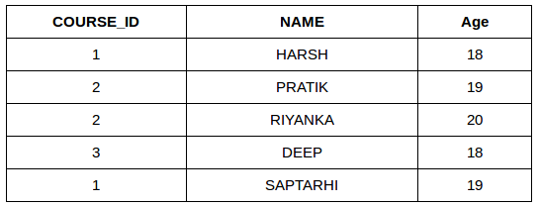
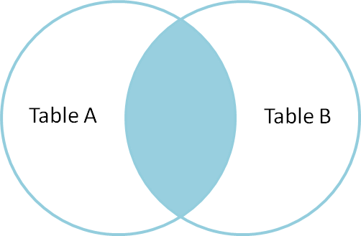
A. INNER JOIN
The INNER JOIN keyword selects all rows from both the tables if the condition is satisfied.
SELECT StudentCourse.COURSE_ID, Student.NAME, Student.AGE FROM Student INNER JOIN StudentCourse ON Student.ROLL_NO = StudentCourse.ROLL_NO;

Slide 48
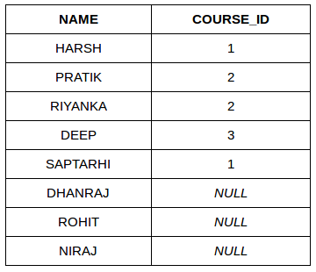
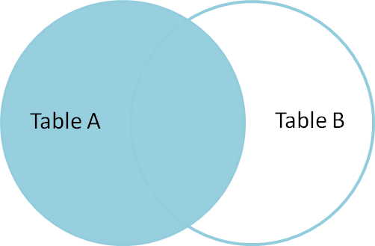
B. LEFT (OUTER) JOIN
This join returns all the rows of the table on the left side of the join and matches rows for the table on the right side of the join. For the rows for which there is no matching row on the right side, the result-set will contain null. SELECT Student.NAME,StudentCourse.COURSE_ID FROM Student LEFT JOIN StudentCourse ON StudentCourse.ROLL_NO = Student.ROLL_NO;

Slide 49
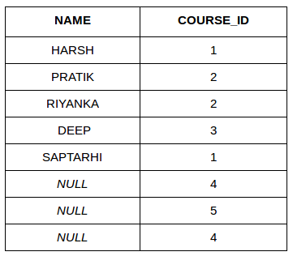
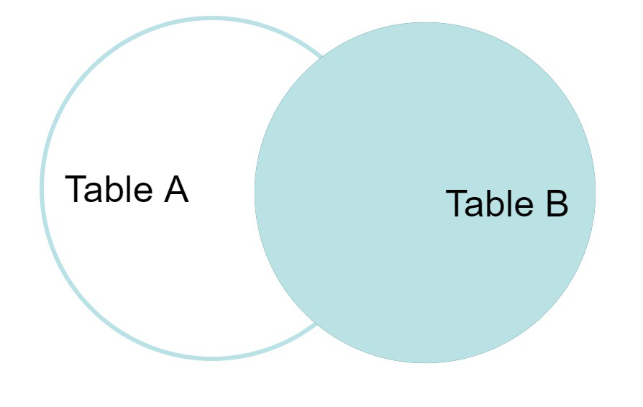
C. RIGHT (OUTER) JOIN
This join returns all the rows of the table on the right side of the join and matching rows for the table on the left side of the join. For the rows for which there is no matching row on the left side, the result-set will contain null. SELECT Student.NAME,StudentCourse.COURSE_ID FROM Student RIGHT JOIN StudentCourse ON StudentCourse.ROLL_NO = Student.ROLL_NO;

Slide 50
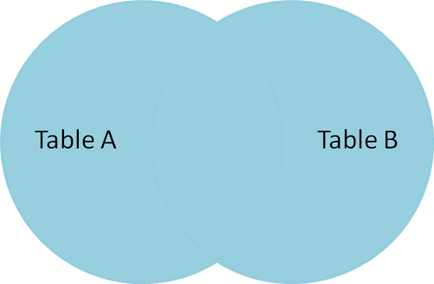
D. FULL JOIN
FULL JOIN creates the result-set by combining results of both LEFT JOIN and RIGHT JOIN. The result-set will contain all the rows from both tables. For the rows for which there is no matching, the result-set will contain NULL values. SELECT Student.NAME,StudentCourse.COURSE_ID FROM Student FULL JOIN StudentCourse ON StudentCourse.ROLL_NO = Student.ROLL_NO;
NAME | COURSE_ID
HARSH | 1
PRATIK | 2
RIYANKA | 2
DEEP | 3
SAPTARHI | 1
DHANRAJ | NULL
ROHIT | NULL
NIRAJ | NULL
NULL | 4
NULL | 5
NULL | 4

Slide 51
E. NATURAL JOIN
Natural Join joins two tables based on same attribute name and datatypes. The resulting table will contain all the attributes of both the tables but keep only one copy of each common column. SELECT * FROM Student NATURAL JOIN StudentCourse

Slide 52
Data Integrity
The following categories of data integrity exist with each RDBMS −
Entity Integrity − This ensures that there are no duplicate rows in a table.
Domain Integrity − Enforces valid entries for a given column by restricting the type, the format, or the range of values.
Referential integrity − Rows cannot be deleted, which are used by other records.
User-Defined Integrity − Enforces some specific business rules that do not fall into entity, domain or referential integrity.

Slide 53
Integrity Constraints
Integrity constraints are a set of rules. It is used to maintain the quality of information.
Integrity constraints ensure that the data insertion, updating, and other processes have to be performed in such a way that data integrity is not affected.
Thus, integrity constraint is used to guard against accidental damage to the database.
Types of Integrity Constraints:
Domain constraints
Entity Integrity Constraint
Referential Integrity Constraint
Key Constraint

Slide 54
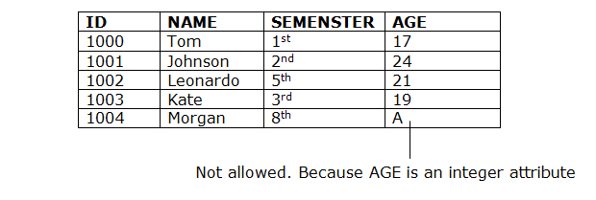
1. Domain constraints
Domain constraints can be defined as the definition of a valid set of values for an attribute.
The data type of domain includes string, character, integer, time, date, currency, etc. The value of the attribute must be available in the corresponding domain.

Slide 55
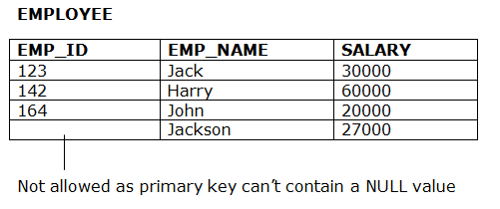
2. Entity integrity constraints
The entity integrity constraint states that primary key value can't be null.
This is because the primary key value is used to identify individual rows in relation and if the primary key has a null value, then we can't identify those rows.
A table can contain a null value other than the primary key field.

Slide 56
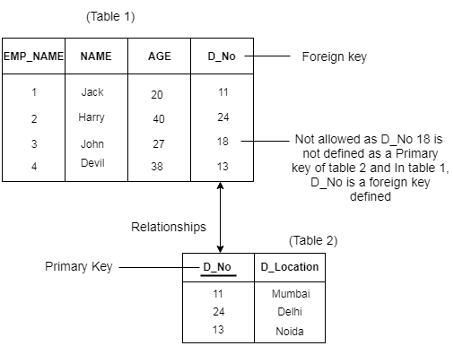
3. Referential Integrity Constraints
A referential integrity constraint is specified between two tables.
In the Referential integrity constraints, if a foreign key in Table 1 refers to the Primary Key of Table 2, then every value of the Foreign Key in Table 1 must be null or be available in Table 2.

Slide 57
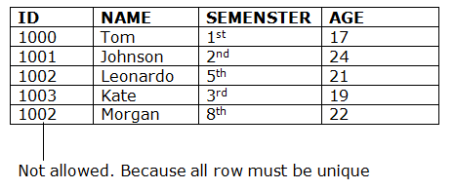
4. Key constraints
Keys are the entity set that is used to identify an entity within its entity set uniquely.
An entity set can have multiple keys, but out of which one key will be the primary key. A primary key can contain a unique and null value in the relational table.

Slide 58
Thank You

